Slide 1


Visualizing Carbon Footprints Across Sectors Using Power BI
Name: P.Reshma
E-mail: reshmapatan915@gmail.com

Slide 2

Learning Objectives:
1. Analyze Sector-Wise Carbon Emissions
Understand how key sectors (power, Energy, Transport, Industry, Agriculture, Residential) contribute differently to greenhouse gas emissions.
Identify emission-heavy sectors and analyze regional or global variations in carbon footprints.
🧹 2. Master Data Preparation Techniques
Learn how to clean and transform raw datasets using Power Query Editor:
Handling missing or inconsistent values.
Standardizing formats and units (e.g., converting all emissions to metric tons CO₂e).
🔗 3. Understand Data Modeling Concepts
Create a logical data model using star schema:
Design relationships between fact (emissions data) and dimension tables (sectors, years, regions).
Apply normalization and data granularity best practices.
Use this model to support dynamic filtering and aggregation.
4.Build and Customize Visual Reports
Develop intuitive dashboards using Power BI visuals:
Line charts for time-series emission trends.
Bar and column charts for sector comparisons.

Slide 3

Tools and Technology used
Primary platform for data visualization, transformation, and report creation.
🧰 1. Microsoft Power BI
Used Power Query Editor to:
Clean raw datasets (remove nulls, filter data, format columns).
Apply data transformations (merging, appending, pivoting/unpivoting).
Leveraged Data Model features to:
Build relationships between tables (sectors, time, emissions).
Create calculated columns and measures using DAX.
Designed interactive dashboards and reports using:
Slicers, cards, bar/line charts and KPIs.
📊 2. DAX (Data Analysis Expressions)
Used to write custom measures and calculated fields:
Total Emissions, Sector-wise Contributions, Year-over-Year % Change.
Dynamic filters and aggregation logic based on user input.
🔎 3. Power Query (M Language)
Employed for data shaping and transformation at the ingestion stage.
Helped automate repetitive data cleaning tasks and ensure consistent structure across datasets.

Slide 4
Methodologies
Data Acquisition:
Source: Emissions data compiled from government databases or international environmental organizations (e.g., UNFCCC, EPA, IEA).
Scope: Included sector-specific carbon footprint data – Energy, Transport, Industry, Agriculture, and Residential – across multiple years.
2. Data Cleaning & Transformation:
>Utilized Power Query Editor to:
Remove duplicates, handle missing values, and convert data types.
Standardize units (e.g., CO₂e in metric tons) for consistency across sectors.
Apply calculated columns to derive per-capita and percentage share metrics.
3. Data Modeling:
>Created a star schema structure with:
Fact table: Emissions data containing values, years, sectors.
Dimension tables: Sectors, Regions, Time Periods.
>Defined relationships for interactive filtering and aggregation.
>Used DAX for measures such as:
Total Emissions
Year-over-Year Change
Sector Contribution %
4. Visualization Design:
>Built interactive dashboards using:
Methodology

Slide 5
>Built interactive dashboards using:
Bar charts and line graphs to show emission trends over time.
Different charts,maps for sectoral contribution breakdown.
Slicers for filtering by year, region, or sector.
>Focused on color-coding and tooltips for user-friendly insights.
5. Analytical Approach
>Emphasized comparative analysis:
Which sectors contribute most to carbon footprints?
How have emissions changed over time?
>Enabled scenario-based filtering for policy simulation or target-setting.

Slide 6
Problem Statement:
Climate change is driven largely by increasing carbon emissions, yet it’s challenging to identify which sectors contribute most.
Emissions data is often fragmented, non-visual, and hard to analyze, making it difficult for stakeholders to make informed decisions.
There is a need for a centralized, interactive dashboard to visualize and compare sector-wise emissions over time.
This project aims to transform raw emission data into actionable insights using Power BI, helping users explore patterns, trends, and sectoral contributions effectively.

Slide 7
Solution:
1. Centralized Carbon Emission Dashboard:
To address the fragmented nature of carbon emission data across sectors, we developed a unified Power BI dashboard. This platform aggregates emissions data from various industries, enabling a holistic view of environmental impact. By bringing all the data into one place, stakeholders can easily assess and compare sector-wise footprints.
2. Sector-Specific Visualization:
Each sector—including Energy, Transportation, Agriculture, Manufacturing, and Residential—is visualized independently with bar charts, pie charts, and heat maps. This segmentation allows users to isolate and analyze the contribution of each industry to the total carbon output, offering clear visibility into the most impactful areas.
3. Interactive Filtering and Drill-Downs:
> The dashboard includes slicers and filters that allow users to:
> Select specific time periods (monthly, yearly)
>Compare emission trends across regions
>Drill down from sector-level to sub-sector or company-level data (where applicable)
4. Temporal Trend Analysis:
Time-series visualizations were implemented to show how carbon emissions have changed over the years. This helps stakeholders:
>Identify spikes or reduction
>Correlate emissions with policy changes or industrial activities
>Forecast future trends based on historical patterns

Slide 8
5. Sector-Wise Carbon Emissions Breakdown
Visualizations Used:
>Clustered Column Charts to display total CO₂ emissions by sector.
>Stacked Bar Charts for emissions by subsector or activity type.
Purpose: Helps users visually compare how each industry (e.g., Energy, Transport, Manufacturing) contributes to total emissions.
6. Time-Based Trend Analysis
Visualizations Used:
>Line Graphs to track changes in carbon emissions over time (monthly and yearly).
>Area Charts to show cumulative emissions trends.
Purpose: Highlights increases or decreases in emissions over time, supports policy impact analysis, and identifies long-term patterns.
7. Geographic Mapping
Visualizations Used:
>Filled Map and Bubble Map to display regional or country-wise carbon emissions.
Purpose: Identifies geographical hotspots with high emissions and supports spatial decision-making for targeted interventions.
8. Filters and Slicers (Interactivity)
Filters Used:
>Time Slicer – Year, Quarter, or Month
>Sector Selector – Filter views by specific industr
>Region/Location Selector – Focus on country or region
>Emission Range Slider – Analyze sectors within specific emission levels
Purpose: Enables users to customize views, perform deep dives, and interact with the data in real time.

Slide 9
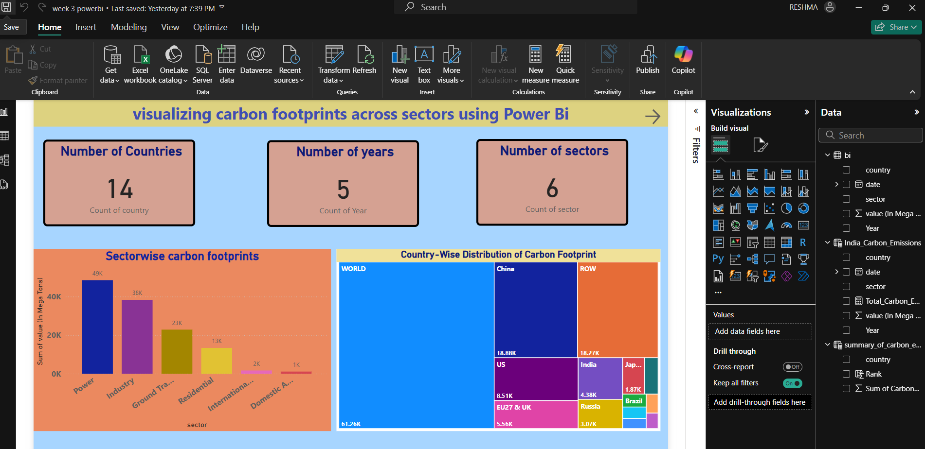
Screenshot of Output:
week1 dashboard:
Key Visualizations:
KPI Cards (Top Section):
Number of Countries: 14
Number of Years Covered: 5
Number of Sectors: 6
➤ These cards provide a high-level summary of the dataset scope.
Clustered Bar Chart (Bottom Left):
Title: Sectorwise Carbon Footprints
➤ Shows total carbon emissions (in Mega Tons) across sectors:
Ground Transport, Residential, International Aviation, and Domestic Aviation
Treemap (Bottom Right):
Title: Country-Wise Distribution of Carbon Footprint
➤ Visualizes the contribution of each country (and region) to global emissions:
Highlights major contributors like China, US, EU27 & UK, India
Slicers & Filters (available on right panel):
Year
Country
Sector
Date

Slide 10
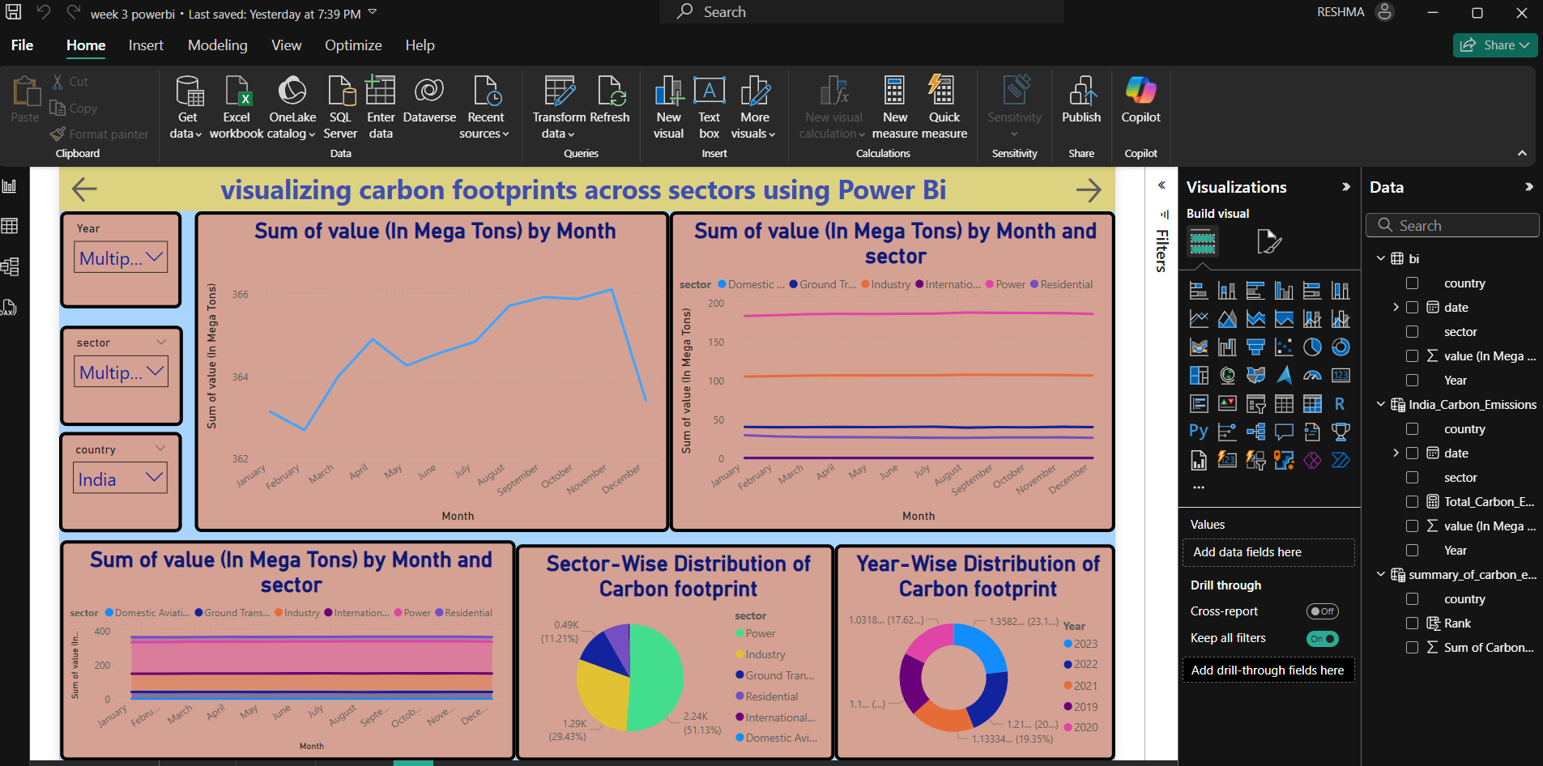
Week 2 dashboard:
Visual Elements Used:
Line Chart (Top Left):
Title: Sum of value (In Mega Tons) by Month
Purpose: Shows the overall carbon emission trend over the months in a selected year.
Line Chart (Top Right):
Title: Sum of value (In Mega Tons) by Month and Sector
Purpose: Tracks emission trends monthly for each sector.
Stacked Column Chart (Bottom Left):
Title: Sum of value (In Mega Tons) by Month and Sector
Purpose: Provides a visual comparison of sector-wise monthly emissions in stacked form.
Pie Chart (Bottom Middle):
Title: Sector-Wise Distribution of Carbon Footprint
Purpose: Displays the overall contribution of each sector to India's carbon footprint.
Donut Chart (Bottom Right):
Title: Year-Wise Distribution of Carbon Footprint

Slide 11
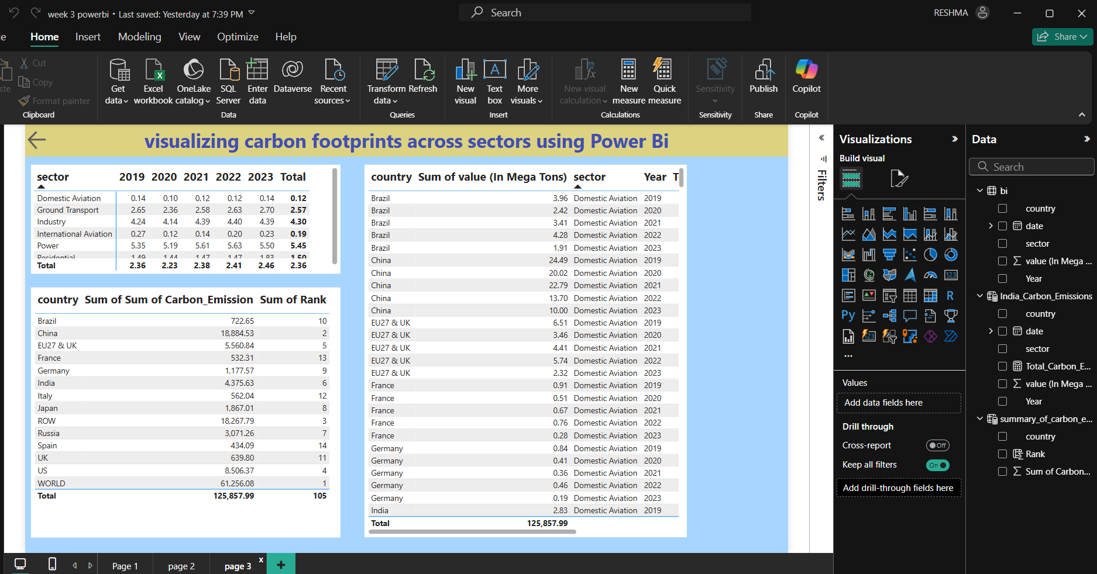
Week 3 dashboard:
📊 Sector-Wise Emissions Over Years (Top Left Table):
>Displays carbon emissions (in Mega Tons) for each sector from 2019 to 2023.
>Power and Industry sectors have the highest consistent emissions over the years.
🌍 Country-Level Emissions Summary (Bottom Left Table):
>Shows total carbon emissions and rank per country.
>China, the US, and the EU rank highest in global carbon emissions.
📋 Detailed Country-Sector-Year View (Right Table):
>Breaks down carbon emissions by country, sector (Domestic Aviation), and year.
>Allows for granular analysis of trends across years and geographies.

Slide 12
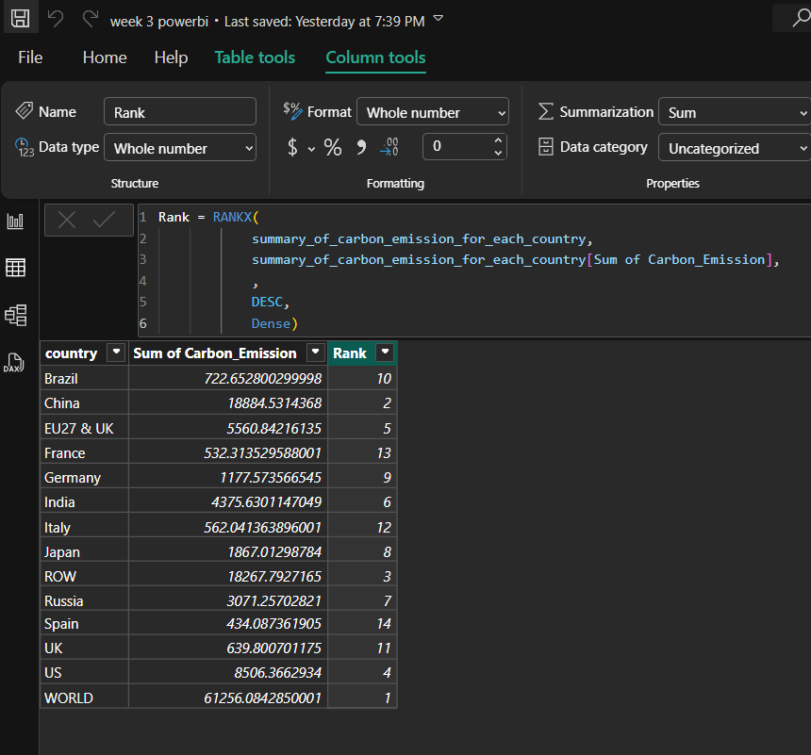
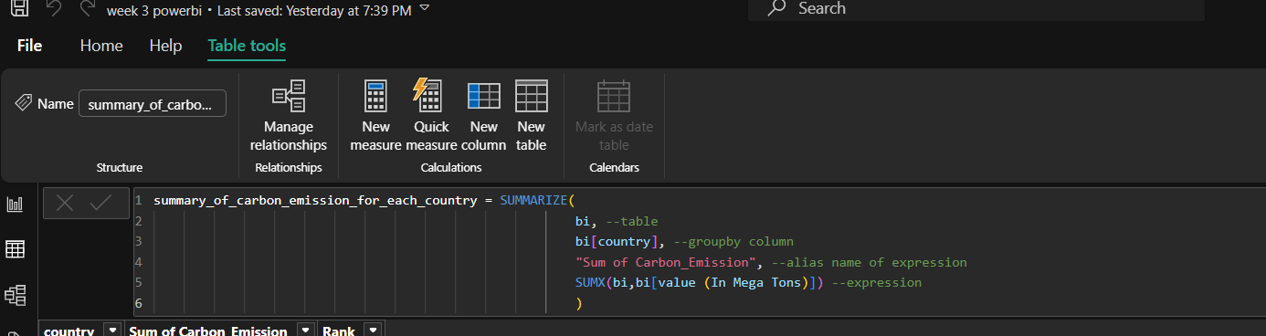
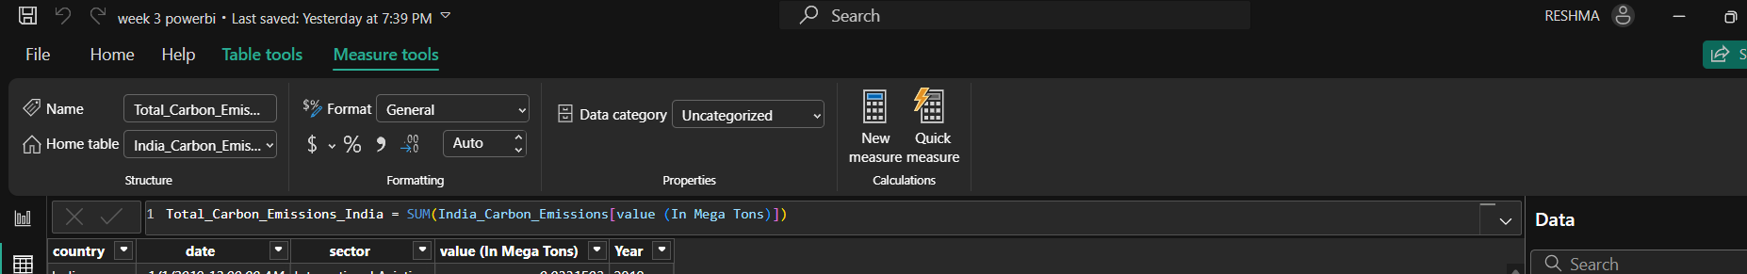
SQL Queries:

Slide 13
GitHub Link: https://github.com/Reshmakhaan/carbon-footprints-visualization-using-powerbi.git
Conclusion:
This Power BI project visualizes carbon footprints across sectors, countries, and years, offering clear insights into emission patterns. It highlights the major contributing sectors like Power and Industry, along with top-emitting countries such as China and the US. The visualizations reveal trends and distribution that support data-driven environmental planning. Overall, it serves as a valuable tool for analyzing and addressing carbon emissions effectively.

